Slide 1
Valency-Augmented Dependency Parsing
Author: Tianze Shi, Lillian Lee (Cornell University)
EMNLP 2018
Presenter: Longxu Dou

Slide 2
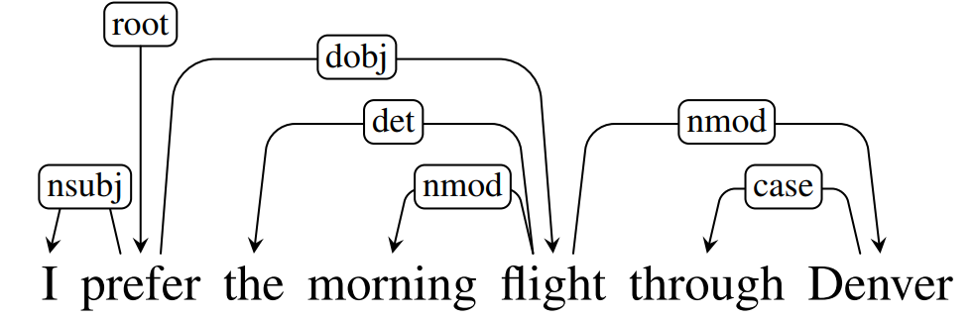
Dependency Parsing
Dependencies are often good for semantic tasks, as related words are close in the tree
Notes:
依存语法 (Dependency Parsing, DP) 通过分析语言单位内成分之间的依存关系揭示其句法结构。 直观来讲，依存句法分析识别句子中的“主谓宾”、“定状补”这些语法成分，并分析各成分之间的关系。

Slide 3
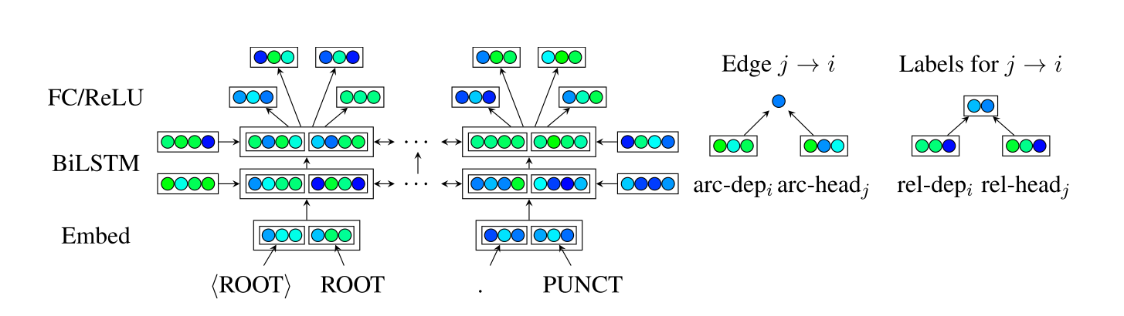
Baseline Architecture-Stanford's Graph-based Parser

Slide 4
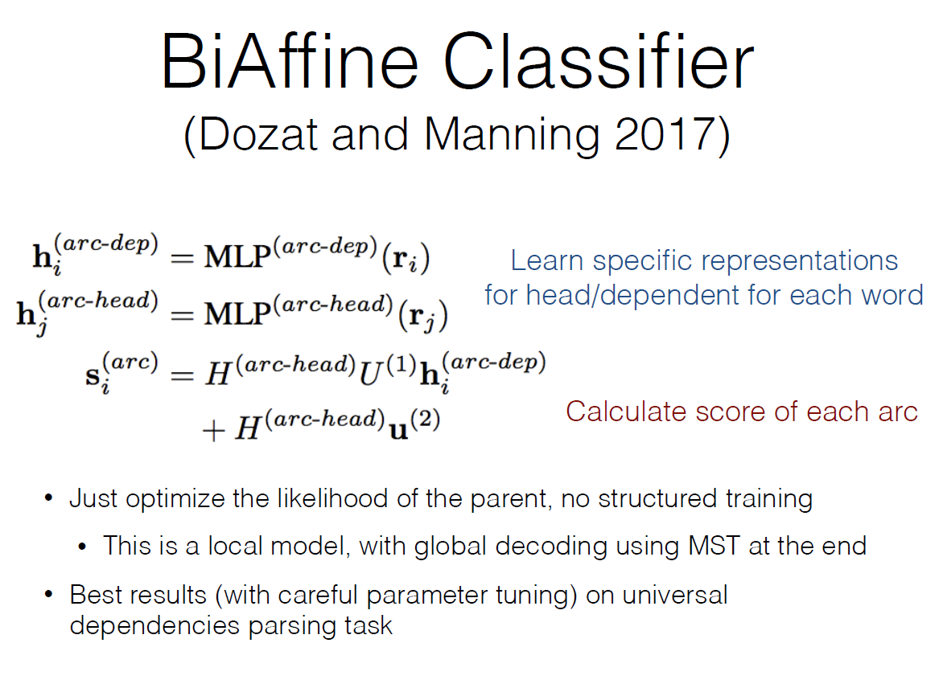

Slide 5
Motivation
Relation labels carry important subcategorization information.
=>Explicitly models sub-categorization of (some) syntactic dependents as valency patterns (supertags).
Notes:
Many dependency parsers treat attachment decisions and syntactic relation labeling as two independent tasks, despite

Slide 6
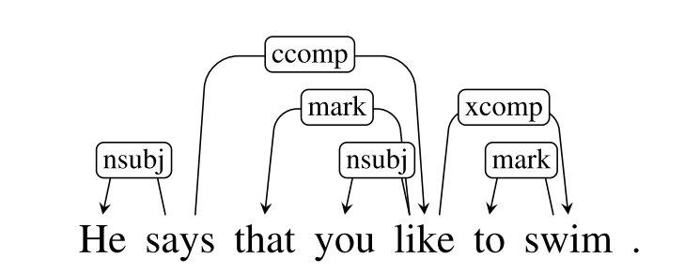




Valency Patterns
:
, where
Notes:
Nsubj: 名词性主语
Ccomp: 补语从句
Xcomp: 开放主语从句

Slide 7
Language Background
Three node types when analyzing simple predicates:
verb equivalents that describe actions and events
noun equivalents as the arguments of the events
adverb equivalents for detailing the circumstances.
The valency of an atom determines the number of bonds it can engage in.
A verb can attract a certain number of arguments
Notes:
There are two types of relations: (1) verbs dominate nouns and adverbs through a dependency relation; (2) verbs and nouns are linked through a valency relation.

Slide 8
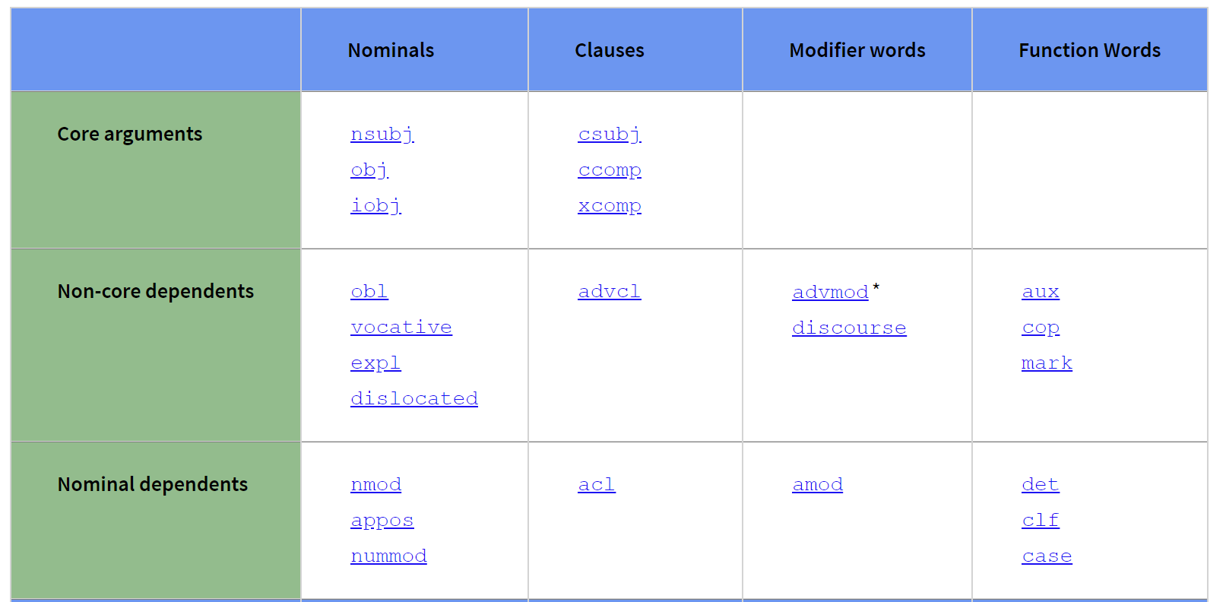
Dependency relations from the UD

Slide 9
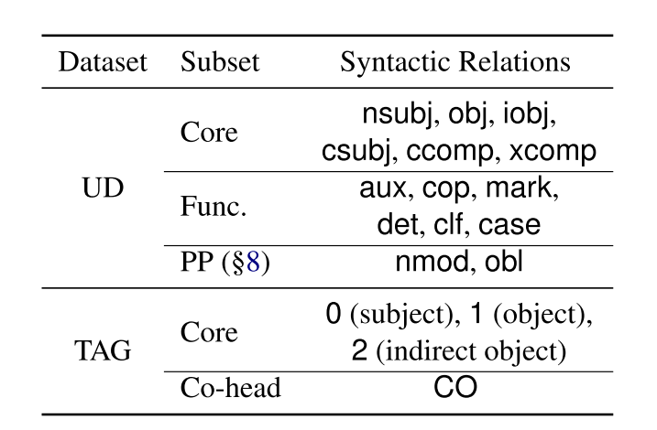
Sets of syntactic relations

Slide 10
Pipeline
Extraction of valency patterns
A probabilistic model for tagging these patterns
A joint decoding process by considering the number and types of each token's syntactic dependents

Slide 11
How well do the extracted patterns generalize to unseen data?
The average number of valency patterns we extract is 110.4 per training treebank
On average, out of the 55.4 patterns observed in the goldstandard test sets, only 5.5 are new and unseen with respect to training.
In comparison, 36.2% of the word types appearing in the test sets are not seen during training.
Notes:
The first question checks the feasibility of learning valency patterns from a limited amount of data
with Turkish (tr) having the fewest at 34, and Galician (gl) having the most at 298
We observe that in general, languages with higher degree of flexibility in word order tend to generate more patterns in the data

Slide 12
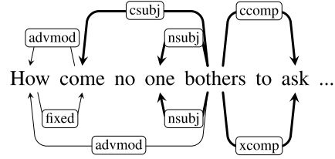
Do SOTA parsers already capture the notion of valency implicitly, though they are not explicitly optimized for it?
All systems are remarkably “hallucinatory” in inventing valency relations, introducing 16.8 to 35.5 new valency patterns, sig- nificantly larger than the actual number of unseen patterns.

Slide 13


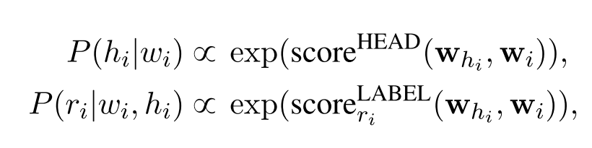
Overview
supertaggers

Slide 14
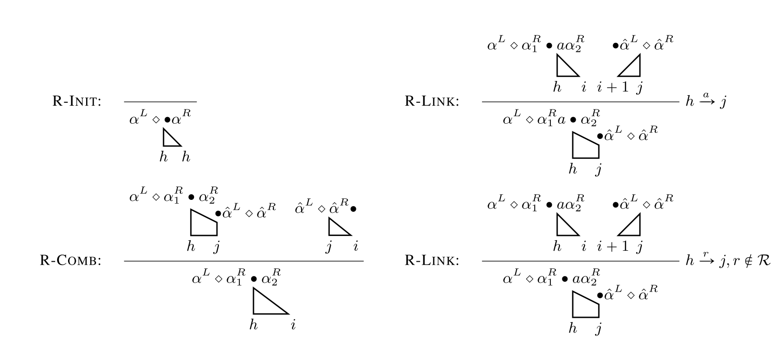
Decoding: Eisner's algorithm

Slide 15
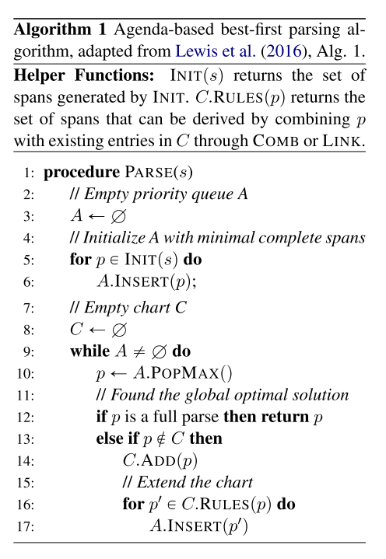
Decoding: A* Parsing
A: open list
C: close list
Blog about A* algorithm:
https://www.cnblogs.com/21207-iHome/p/6048969.html

Slide 16
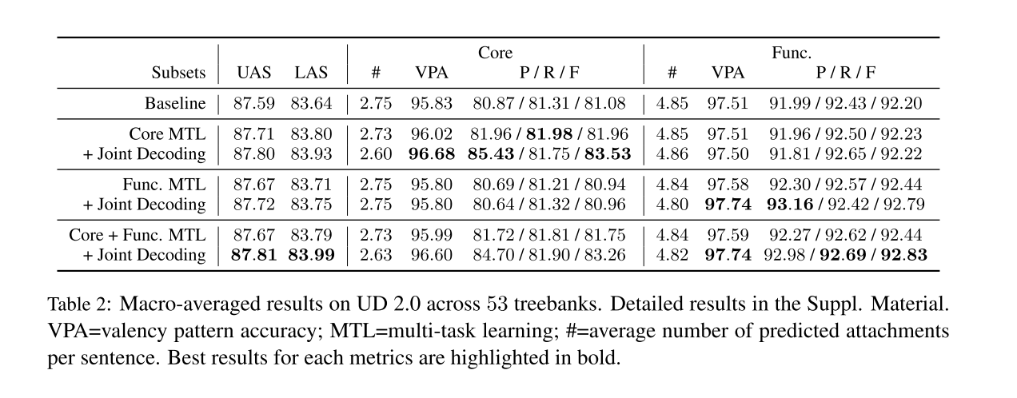
Experimental results on UD

Slide 17
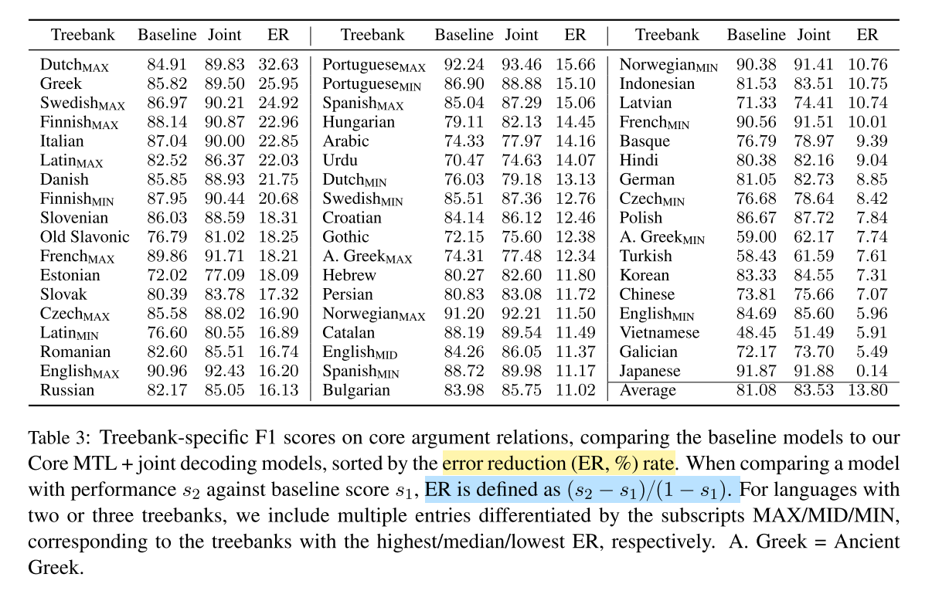
Experimental results on UD

Slide 18
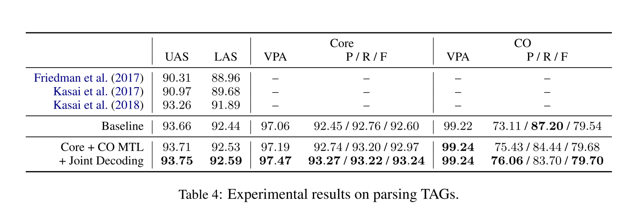
Parsing Tree Adjoining Grammar
Notes:
We further show that our approach is not limited to a particular treebank annotation style. We apply our method to parsing another grammar formalism

Slide 19
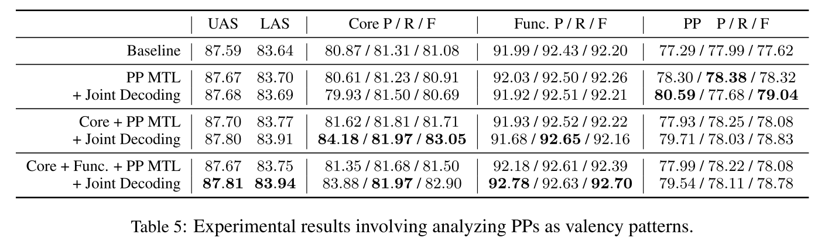
Case Study on PP Attachment
It can be a general method for training parsers to focus on specific subsets of syntactic relations.

